Slide 1


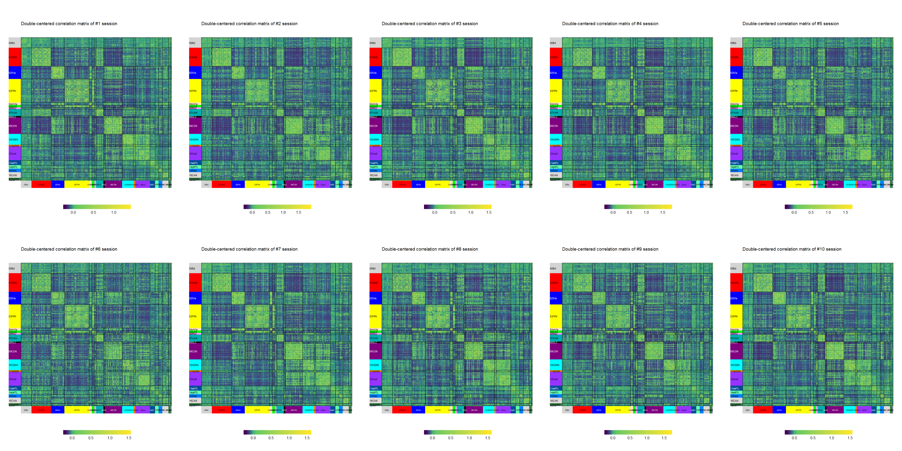
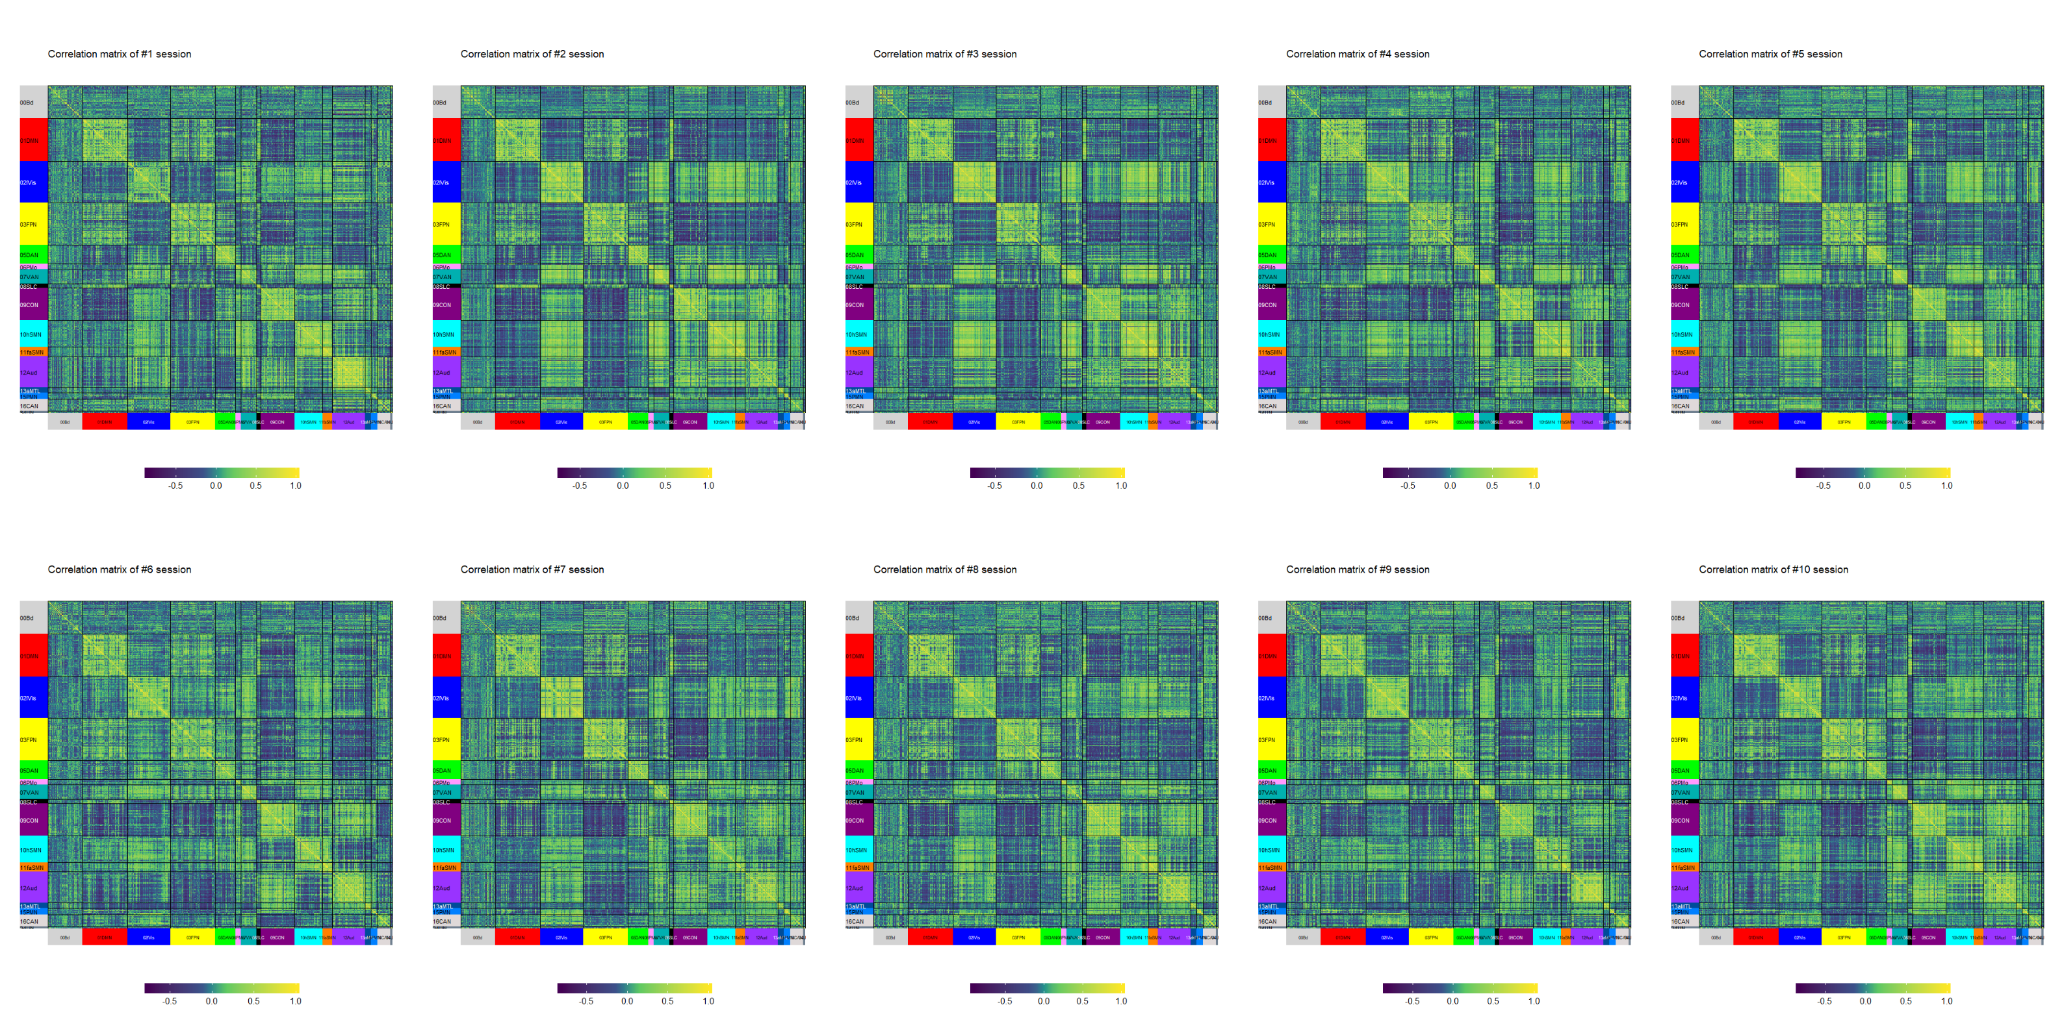
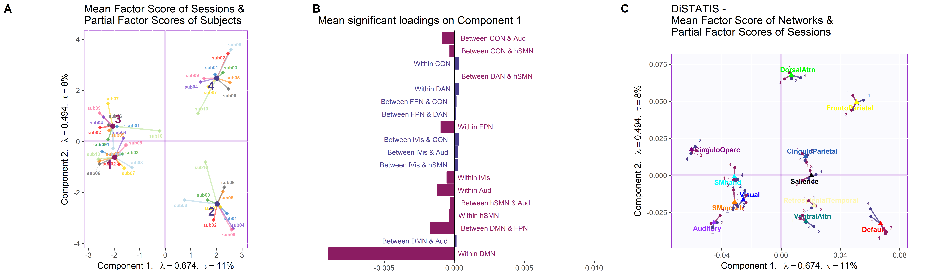
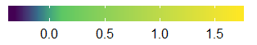
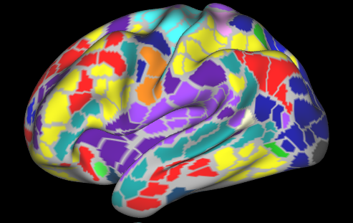
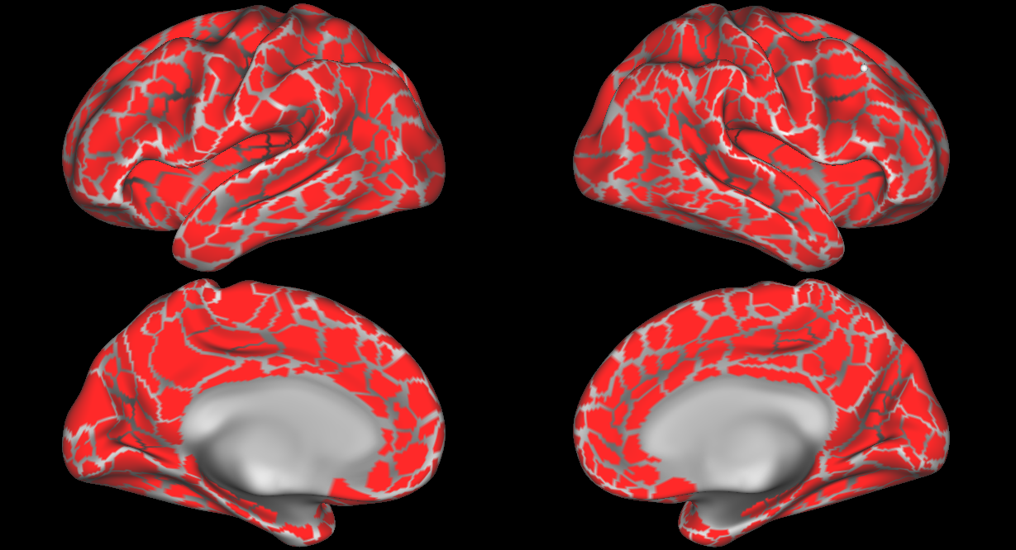
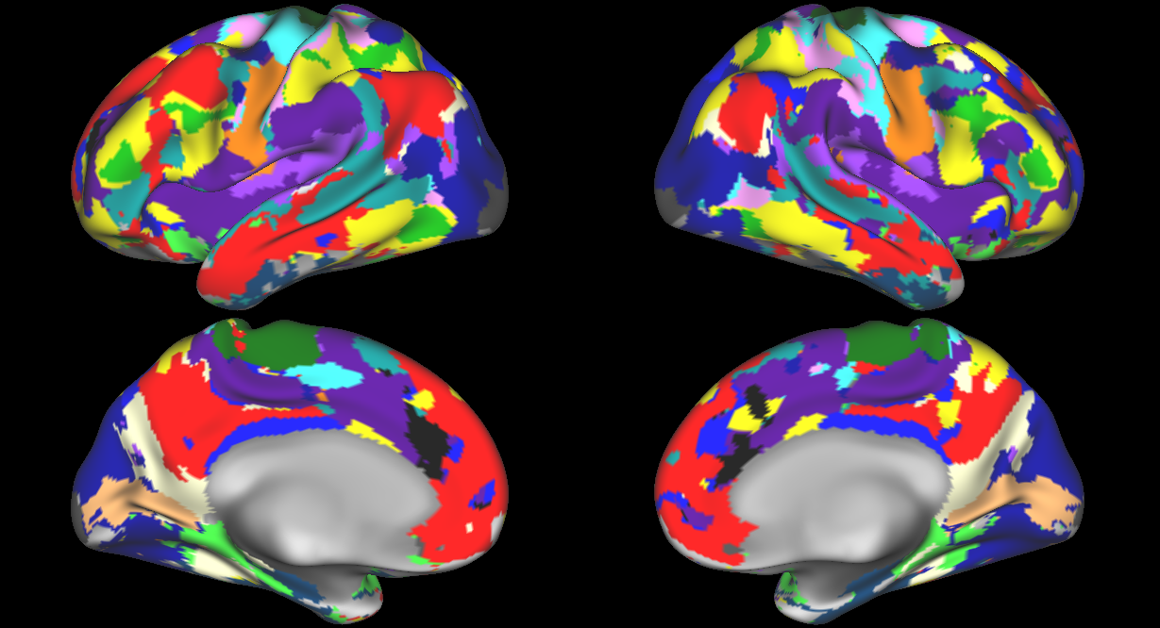
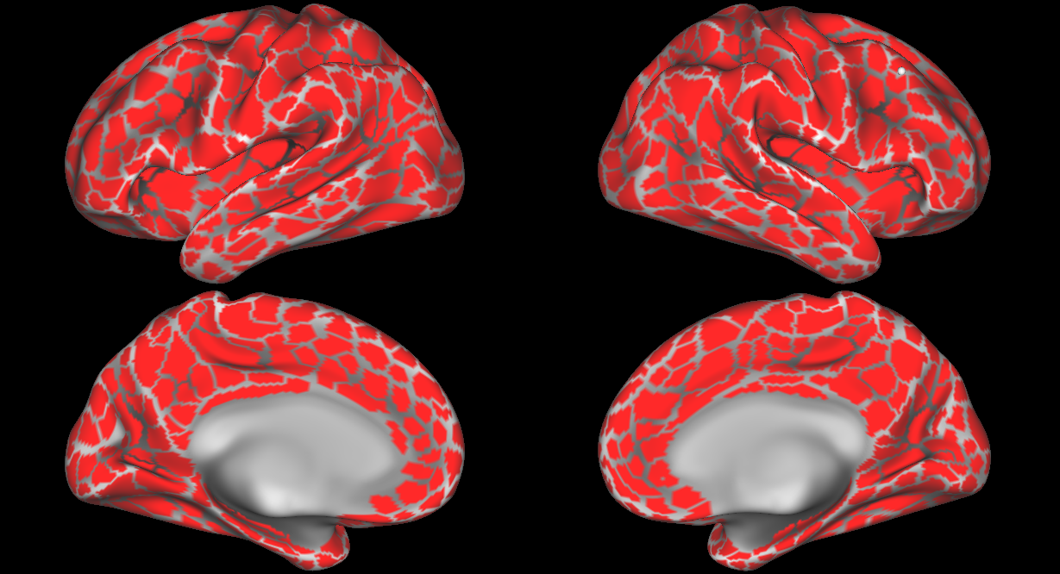
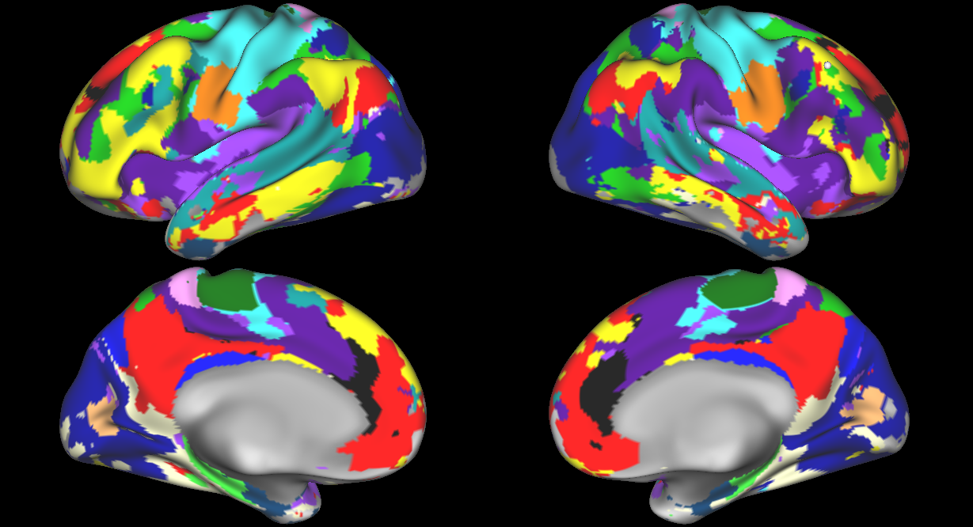
A multivariate approach to analyze connectivity matrices with individual-specific parcellation
Ju-Chi Yu¹, Micaela Chan^{1,2}, Han Liang^{1,2} & Hervé Abdi¹
1. School of Behavior and Brain Sciences, the University of Texas at Dallas; 2. Center of Vital Longevity, the University of Texas at Dallas
Ju-Chi.Yu@utdallas.edu, mchan@utdallas.edu, Liang.Han@utdallas.edu, herve@utdallas.edu
1. Introduction
3. Examples of connectivity matrices
5. Simulations
Background
Recent work in resting-state fMRI (rsfMRI) analysis can derive subject-specific parcellations and sub-networks.
Standard approaches for rsfMRI:
Graph/network analysis accommodates different numbers of parcels/sub-networks.
Requires correction for multiple comparisons when examining sub-networks.
Multivariate analysis (e.g., MDS, DISTATIS) requires the same number of parcels/sub-networks.
Usually achieved by using a shared template.
Biases against individuals that vary greater from the target template.
The above issues from standard approaches are particularly problematic for studies involving subjects that exhibit larger variance in brain structure and function (e.g., elderly, lesion patients, children).
Aim
To develop a new multivariate technique that allows different numbers of parcels and sub-networks.
MSC01 (Sessions 1-5)
Sessions selection
4 sessions from MSC were kept
Only the second and the fourth sessions were simulated
Simulating aging effect
Decreased within DMN
Increase between DMN and FPN
Increase between DMN and DAN
MSC07 (Sessions 1-5)
Default (DMN)
Common Sub-networks
Ventral attention
Visual
Frontal-parietal control (FPN)
Cingulo-opercular control
Auditory
Dorsal Attention (DAN)
6. Results
Hand somato-motor
Mouth somato-motor
Common networks across participants were selected for the analysis.
Negative and perfect z-transformed correlations were excluded from further analysis.
Scale
4. Hierarchical multiple factor analysis
Parcel’s mean time series during resting-state scan
Cross correlation between parcels
Fisher’s Z-transformed
Frames
Session 1
Session 2
…
…
…
…
Session 10
2. Resting-state data set
Midnight Scan Club (MSC; Gordon et al, 2017)
Resting-state fMRI (30 minutes)
10 participants x 10 sessions
Subject-specific parcellations and sub-networks
…
…
…
…
Session 1
Subj 1
Subj 2
Subj 3
…...
Subj N
Session 2
PCA
Parcellation
Sub-networks
Parcellation
Sub-networks
…
Session 10
MSC01
MSC07
➗ 𝛿₁
Normalize subject block by its first singular value, and then…
Parcel’s mean time series during resting-state scan
Cross correlation between parcels
➗ 𝛿’₁
➗ 𝛿’₁
Normalize between/within edge block by its first singular value
Fisher’s Z transformation
Each participant contributes equal amount of variance to the first component.
Between- and within-network connectivity of each participant also contribute equal amount of variance to the first component.
Frames
Extract time series and create correlation matrix for each session of each subject

